Slide 1

In the Great Lakes Bay Region

Slide 2
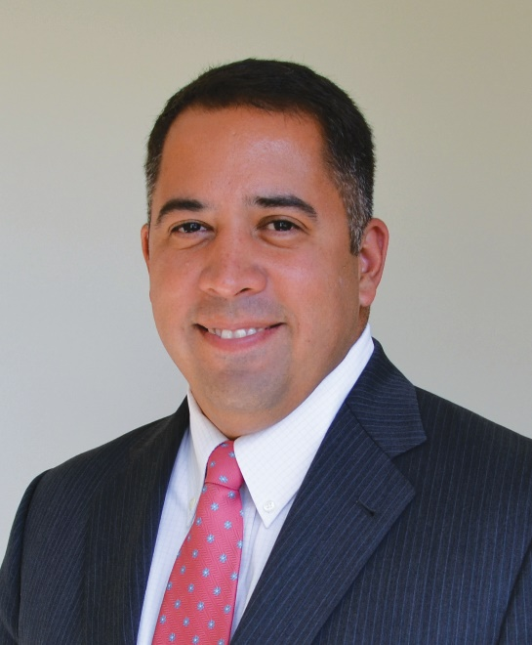
Great Lakes Bay Regional Alliance
Matt Felan
President and CEO
What do we do?
  Business Attraction
  Transportation & Infrastructure
  Advocacy
  Healthcare
  Arts and Entertainment
  STEM Education

Slide 3
STEM Impact Initiative
Local: GLBRA STEM Initiative
Lori Flippin
STEM Initiative Leader
(989)695-6100
lflippin@greatlakesbay.org
www.stempipeline.com
State: MI STEM Advisory Council
National: Great Lakes Bay STEM Ecosystem – National STEM Funders Network
    53 groups around the country (1 in Canada)

Slide 4
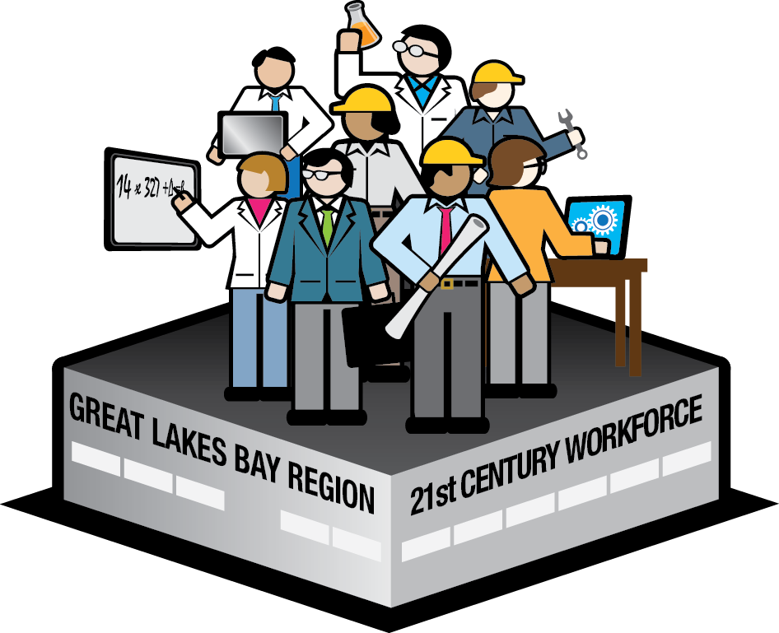
Requirements for an Effective STEM Talent Pipeline
Powered by
Career & College
Ready Students
Driven by
Employer Demand
Sustained by
Culture of STEM
Focused on
Strengthening
Technical Skills Needed in the Economy

Slide 5
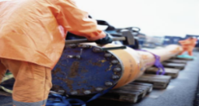

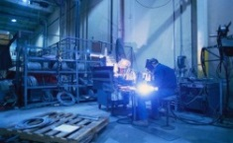

Requirements to Recommendations
STEM Talent Pipeline Requirements
GLBR Recommendations
1.1 Specify technical & workplace skills and competencies for high-demand STEM positions and communicate needs directly to skills providers
1.2 Forecast near term demand and aggregate STEM workforce requirements
Driven by
Employer Demand
2.1 Improve 5th-8th grade math achievement
2.2 Increase in classroom, research-based K-12 STEM aligned programming with evidence of increasing interest in science
2.3 Increase out of classroom experiential STEM learning opportunities
Powered by Career and College Ready Students
3.1 Align programming and curricula with employer requirements
3.2 Scale STEM experiential learning opportunities
Cultivated by Technical
Skills Needed in the
Economy
4.1 Change perceptions and increase interest in STEM
4.2 Eliminate barriers and incentivize students and job seekers to pursue STEM careers
4.3 Create a centralized regional STEM steering mechanism to guide all STEM efforts towards a common goal
4.4 Successfully advocate for policies to support the development of STEM talent pipelines
Sustained by a Culture of STEM

Slide 6

2017 STEM Summit
Business/Education Partnerships
Math
Coding
Regional Update
Career Planning
Internships, job shadowing, etc.

Slide 7
College and Career Readiness
Math in the Mail
Bedtime Math
Middle School Math – 6 pilot programs in 2016-2017
  Teacher Professional Learning Community – Gratiot, Isabella, Clare, Gladwin, Midland
  Great Lakes Bay Region Math Specialist Program - SVSU
  ST Math Student Interventions – Carrollton MS, Handy, Western MS
  Khan Academy Student Interventions – Essexville-Hampton
  Math Counts – After School competition - Freeland

Slide 8

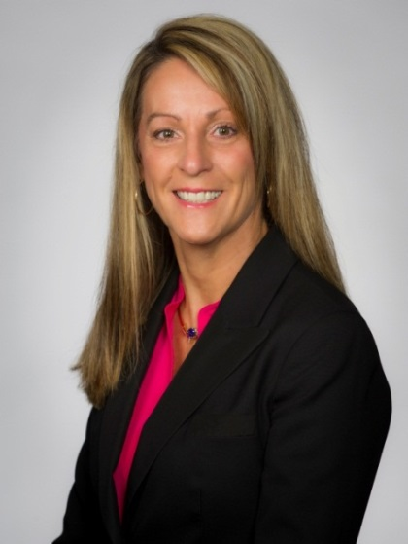
STEM Call to Action -
Computer Science
Melanie Kalmar
Vice President and Chief Information Officer
The Dow Chemical Company
  Coding/Computer Science – Survey data coming soon
  Possible Actions – Student Computer Science Instruction, Teacher Training,
  Student Job shadowing, intern/co-op placements in computer science
  Action Plan - TBD

Slide 9
Out-Of-School Time Network
Over 300 Museums, Zoos, Nature Centers, etc.
Out of School Time STEM Professional Development
Collaboration
Program Promotion on www.stempipeline.com
Incentives for Equitable Access – STEM Passport in development

Slide 10
Chief Science Officers Pilot Program
Saginaw Valley State University
54 students in 3 counties
Expected to continue in 2018-2019
STEM Student Leadership
Staff Mentor Required
Student Election Process
Student Project Required

Slide 11
Employer Talent Pipeline Goals
Create and implement a model for employer-driven experiential learning opportunities to build the talent pipeline.
Implement useful tools for multi-dimensional communication on regional STEM endeavors, creating greater clarity for employers, prospective employees, parents, and students.
Identify and prioritize the occupations for which skill requirements should be defined, using the DACUM process piloted in the current GLBR-Delta Network.
Identify, organize, and improve the many ways in which employers are currently communicating skills and competencies needed to the skill providers (schools, colleges, and training centers).
Assist and support employers so that they can provide thought-leadership on demand forecasting and skill aggregation strategies.

Slide 12
Communication
Stakeholders:
Delta College Webpage (https://www.delta.edu/community/collaborations-outreach/employer-talent-pipeline.html)
Mid Michigan Webpage (https://www.midmich.edu/departments/corporate-continuing-education/internships-apprenticeships)
GLBRA STEM Pipeline Website
(www.stempipeline.com)

Slide 13
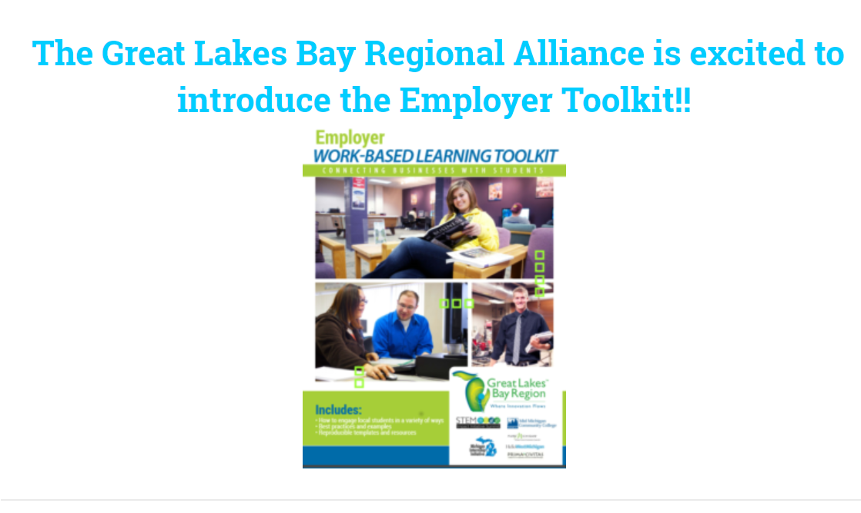

Slide 14
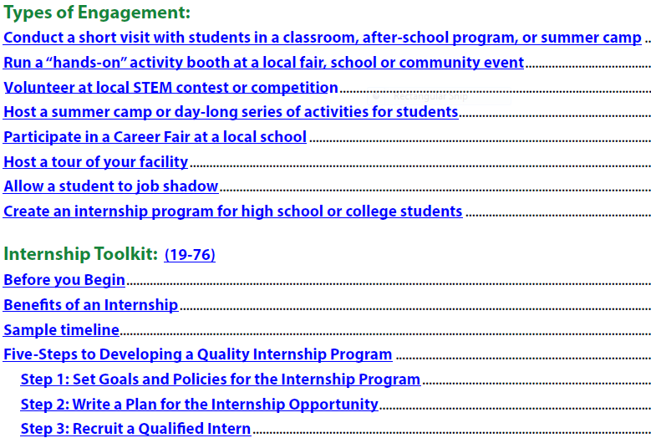
Employer Talent Pipeline – Partnership with Delta College and Mid Michigan Community College
Employer Toolkit to Increase Experiential Learning

Slide 15
Business Representative Input and Participation
Barriers
Generating Interest
Streamlined Communication
Best Practices – Coming Soon
Teacher Externships
Regional Scaling of Experiential Learning
Adapt to demand

Slide 16
Business Partnerships
Q3. Does your business have the desire/ability to expand work-based learning opportunities?
Yes | Which would be most valuable | Timeline for implementation | Contact Person
x | Internship/Co-op(Still could improve. Willing to help others by providing template for WBL.) | ASAP | Name, e-mail, phone number
x | Where it makes sense. | TBD | Name, e-mail, phone number
x | Job Shadow Internship Co-op | Continual | Name, e-mail, phone number
x | Job Shadow Internship Co-op | Anytime | Name, e-mail, phone number
x | Job Shadow Job Fairs Interviews | Working to increase now. | Name, e-mail, phone number
x | More classroom presentations. | Now | Name, e-mail, phone number

Slide 17
Counselor Barriers
Student Credit Requirements
Transportation
Time
Business Willingness
Goals: Expanded Opportunities of Experiential Learning, Ability to Adapt to demand

Slide 18
Technology Based Tool
Career Cruising/MI Bright Future(ccInspire)
  EMCOG Grants

Slide 19

Ways that MI Bright Future can help:
Where can I find an employer to come talk to my class?
I have a student who wants an internship, how can I help?
Where could I take students on a field trip to learn more about careers?
We are having a career fair and need companies to participate, where can I find them?
Is there a local company willing to serve on an employer advisory council?
How can I find out more about a career one of my students is interested in?
Notes:
If you have one of these questions: MI BRIGHT FUTURE CAN HELP!

Slide 20
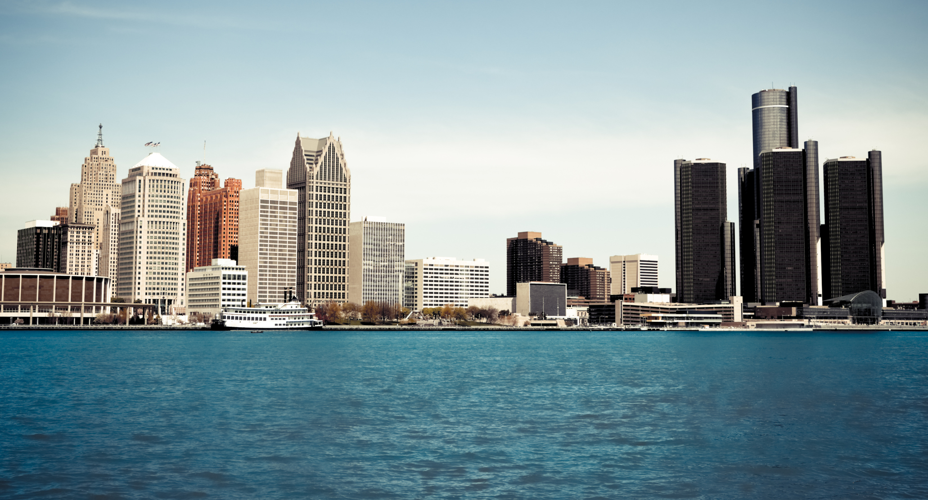


Slide 21
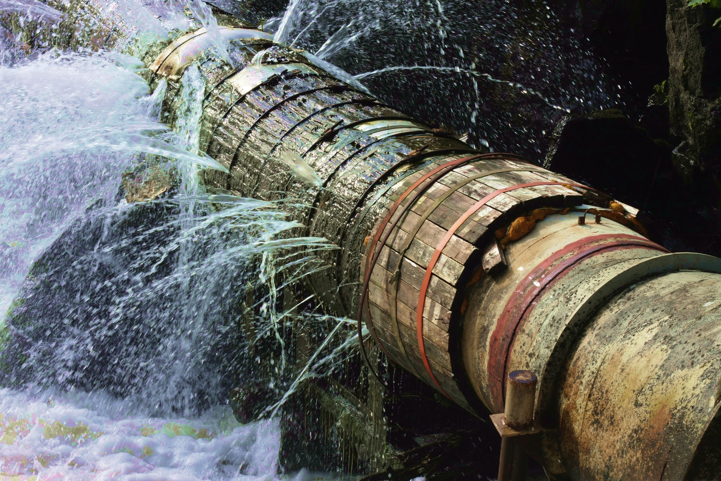

What is the leaking pipeline?

Slide 22
Career Engagement
142,454 high school & middle school students
Livingston, Macomb, Oakland, St. Clair & Wayne Counties
All-Time
All-Time Student
All-Time Student
Occupation
Student Saves
Saves (Male)
Saves (Female)
Professional Athlete
11,407
9,146
1,942
Actor
6,856
1,971
4,581
Video Game Developer
6,652
5,571
882
Doctor
6,030
2,101
3,635
Nurse
5,803
521
4,947
Artist
5,532
1,641
3,604
Veterinarian
5,091
1,050
3,752
Animator
4,914
2,417
2,252
Lawyer
4,835
1,836
2,734
Pediatrician
4,543
412
3,823
Psychologist
4,430
710
3,422
Fashion Designer
4,350
473
3,640
Photographer
4,346
873
3,179
Singer
4,141
802
3,140
Musician
4,016
1,765
2,090
Surgeon
3,905
1,263
2,423
Athletic Therapist
3,667
1,925
1,572
Child and Youth Worker
3,635
265
3,127
Elementary School Teacher
3,604
260
3,100

Slide 23
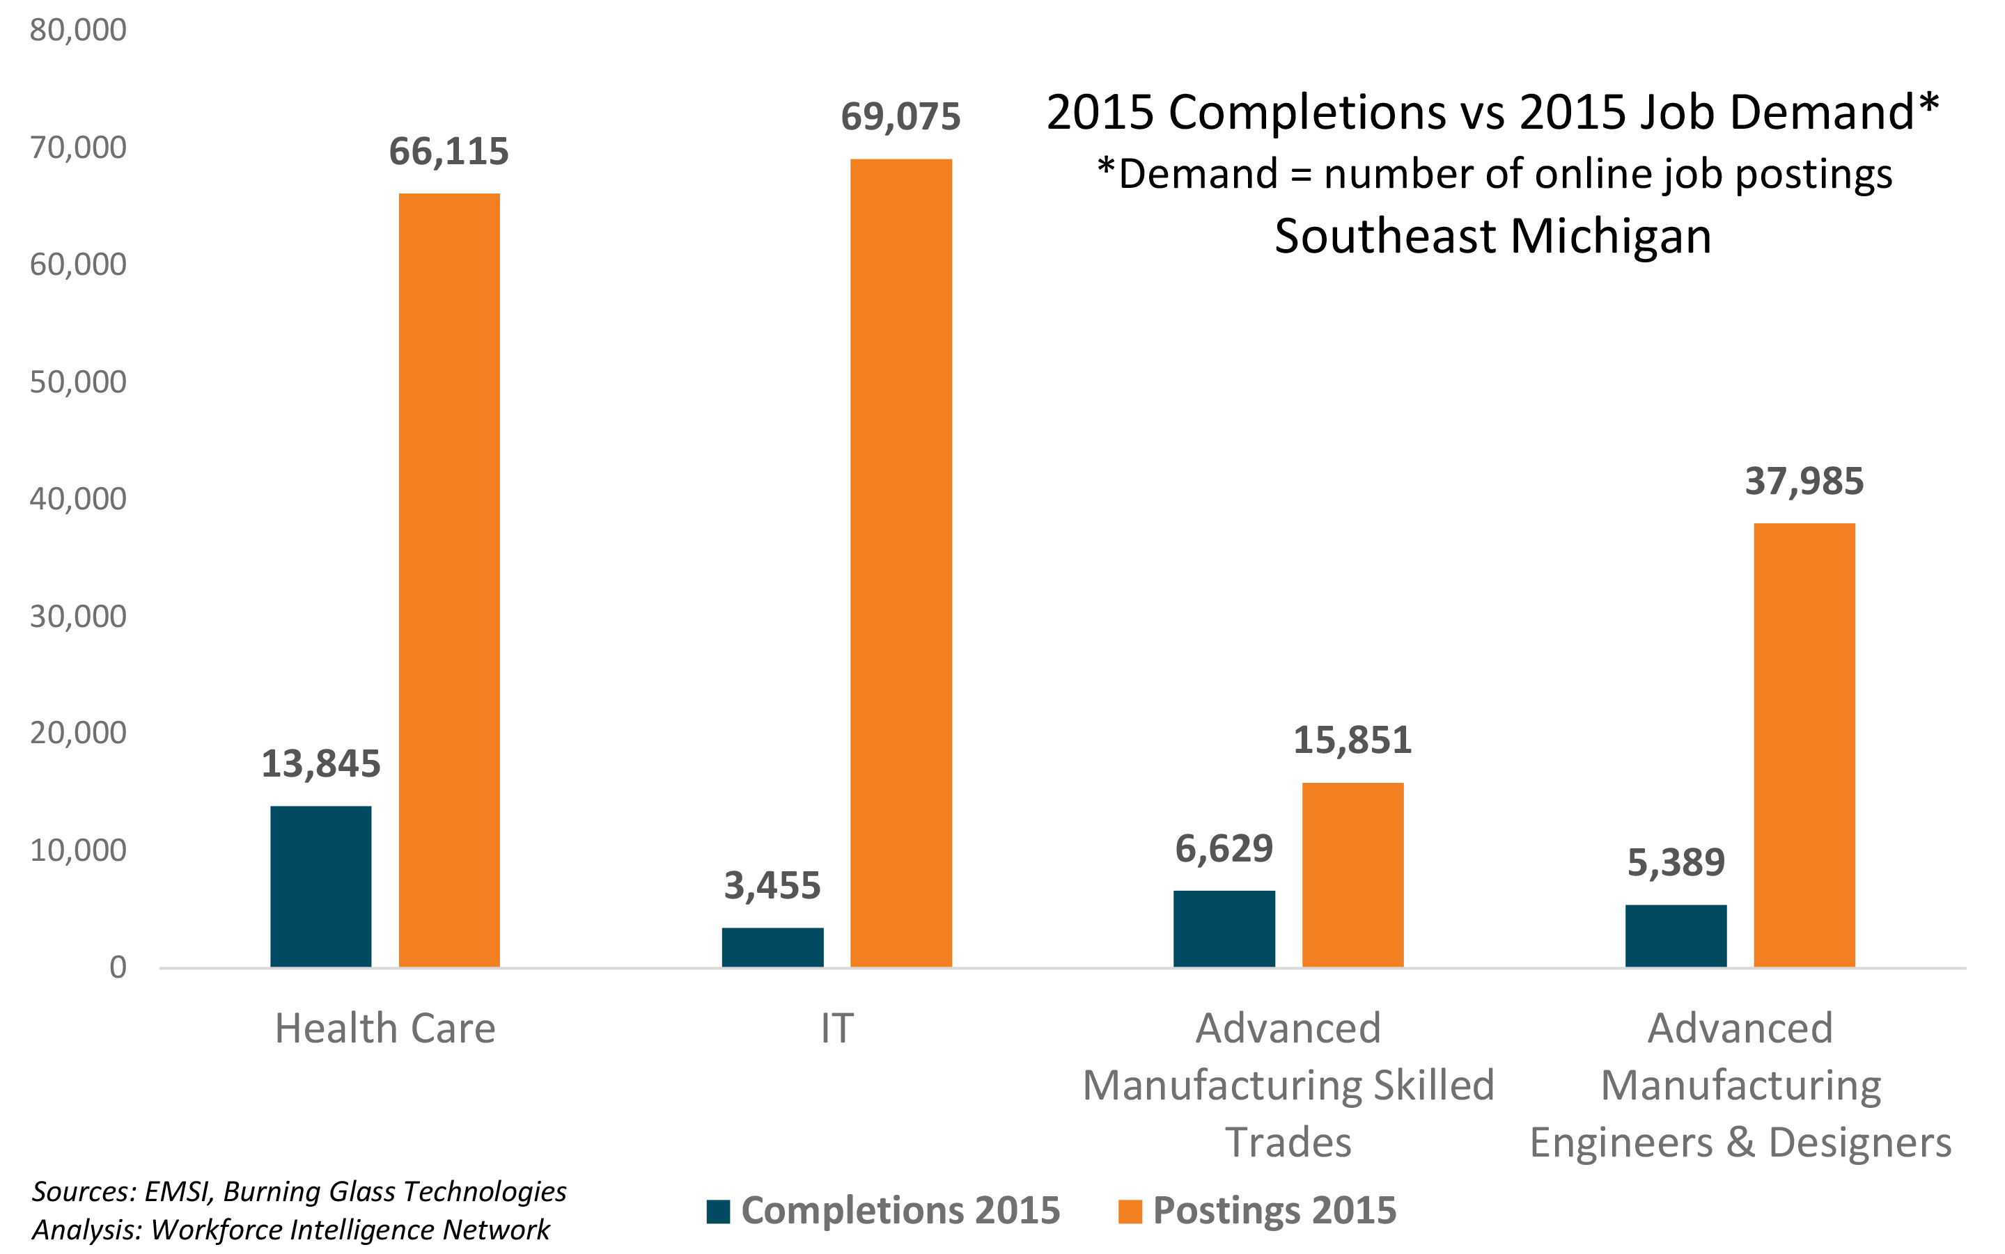
The struggle is real
Demand is between 2.4 and 20 times higher than the number of new graduates each year.

Slide 24

PERFECT STORM
1. Aging workforce
3. Unprepared
workforce
2. Skills gap

Slide 25


THE PROGRAM
MDE requires Educational Development Plans (EDPs)
68%
Majority of Michigan schools use Career Cruising to create EDPs (one of several programs available)
Career Cruising Inspire is an enhancement to the basic EDP software that allows for student/employer interaction
MI Bright Future is a collaboration to bring the enhancement to Michigan schools

Slide 26
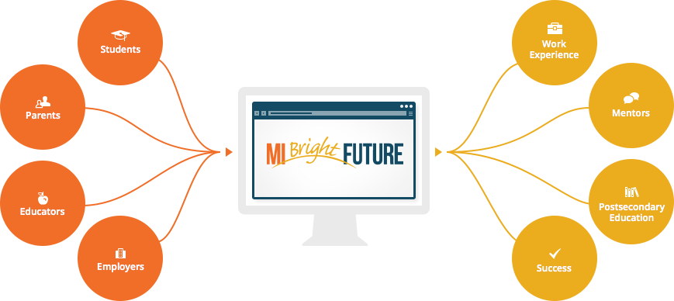
THE PROGRAM

Slide 27


Our Mission
To address the long-term workforce needs in Michigan, especially in high-demand occupations, by supporting the development of an informed, educated, skilled, and experienced talent pipeline.
Our Vision
A robust engagement system between employers, schools, and young people, including their primary advisers and supporters, with a focus on career-related learning and experiences

Slide 28

MI BRIGHT FUTURE AND YOU…
The benefits are:
Marketing opportunities to enhance corporate presence in local community
Streamlined, efficient engagement with local schools
Scalable engagement based on geography, age group, career interest, organization’s capacity to manage, etc.
Ability to highlight in-demand careers to students and identify necessary skills/training

Slide 29
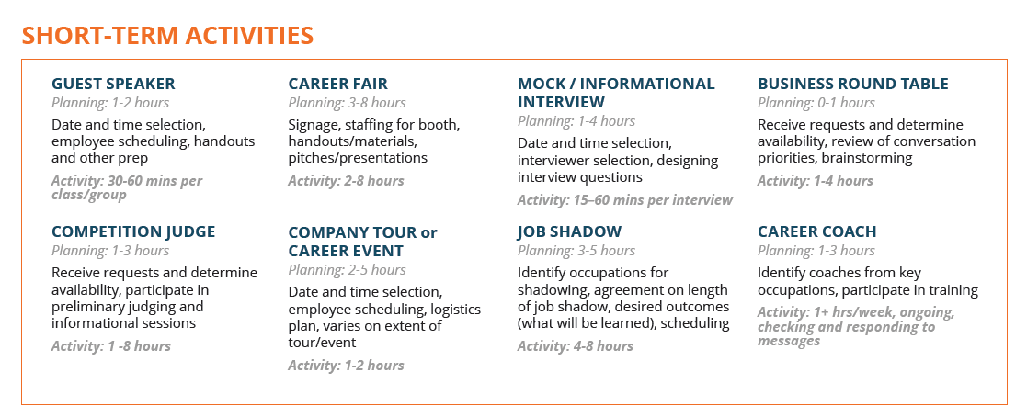
What does getting involved mean?

Slide 30
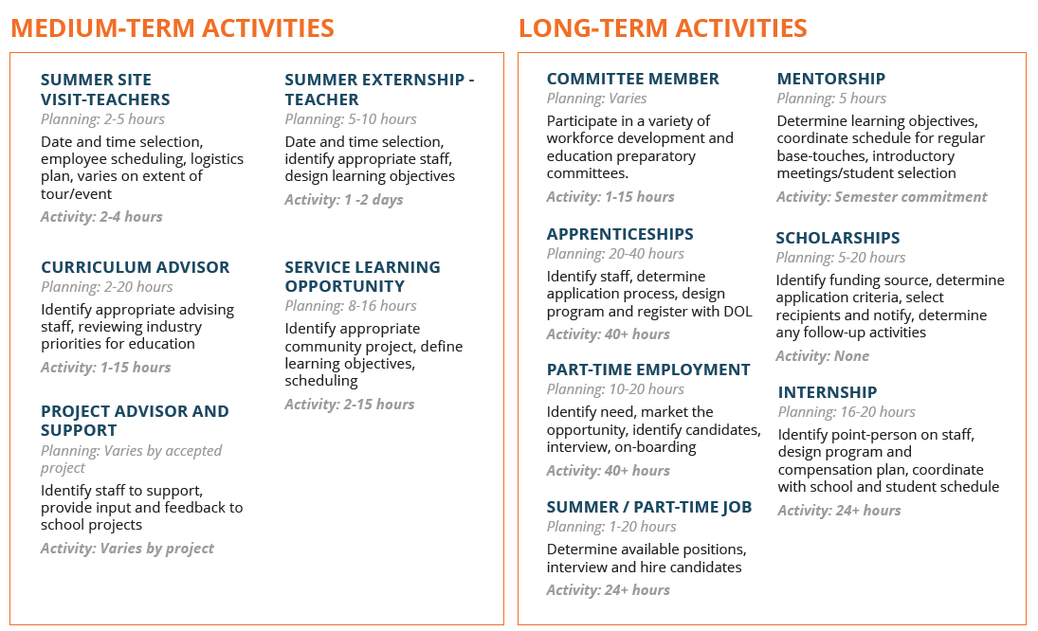
What does getting involved mean?

Slide 31
How do I get my business involved?
Contact an Employer Talent Pipeline Lead to explore options and develop a plan, daniellehall@delta.edu
Refer to the Employer Toolkit for Assistance
Commit to some level of engagement – You Choose!
Register with MI Bright Future

Slide 32
Register
Visit mibrightfuture.org
Under the Employers heading, click Register
Complete the MI Bright Future Registration Form– Be prepared with the items listed above!
Add any additional employees that you would like by using this form
Approve your profile when contacted by the MI Bright Future team
Find your future workforce!
Contact Stacie if you have questions at squast@greatlakesbay.org

Slide 33
Things you will need
Company address and phone
Company logo (.gif or .jpg format)
Company Website URL
Description of your company in student-friendly language (max 700 characters)
Year founded
Number of employees (approximate)
Primary industry
A list of the careers that your company hires that you would like students to know about
HR or career-page web link (if applicable)
Qualities you look for in employees and advice to future employees (700 character max)

Slide 34
Other Regional and State-Wide Actions
Working Together to Improve the GLBR
www.stempipeline.com - Job postings, news and other resources
Nursing and welding skills studies completed
Grant assistance
Going Pro State Campaign - Professional Trades vs Skilled Trades
Career Ready vs College Ready
https://www.mitalent.org/skilled-trades?utm_source=redirects&utm_medium=going-pro&utm_campaign=skill_trades

Slide 35

Collective Action
Making a Difference for the Great Lakes Bay Region
Ultimately, the challenges of the 21st century can't be met without collective action. Agreement will almost never be easy, and results won't always come quickly.

